Slide 1
Lecture 3.3 Monopoly and monopolistic competition

Slide 2
Monopoly
Usually think of a single seller facing a downward sloping market demand curve (no close substitutes). Barriers to entry prevent others capturing excess profit.
Marginal revenue curve is also downward sloping.
Monopolists are hypothesised to act as price makers. They maximize profit in the simplest case by choosing the point where:
Marginal Revenue = Marginal cost
From an overall welfare perspective, there are better pricing options than this.

Slide 3
Monopolistic Competition
Monopolistic competition is a hybrid between monopoly and perfect competition.
Characterised by:
Multiple firms with an assumption that one firm’s actions do not affect the actions of other firms. There is no strategic interaction
Product heterogeneity
Freedom of entry and exit
Examples include retail shops, books, movies and Thai restaurants in Newtown.

Slide 4
Monopolistic Competition
Firms face a downward sloping demand curve and hence have market power.
If firms in the market are generating profit, then you tend to get entry and imitation
In the long run we expect that firms in the industry earn zero economic profit.
This gives rise to the standard monopolistic competition diagram.

Slide 5
Monopolistic Competition
AC
Firms set output equal to Q* where MR=MC to maximise profits. Price (P*) is derived from the demand curve.
Demand
MR

Slide 6
Monopolistic Competition
A richer model of monopolistic competition distinguishes between vertical and horizontal differentiation:
Vertical differentiation: Product is unambiguously better or worse than competing products. Example - cleaning power of dishwashing detergent
Horizontal differentiation: Product is preferred by only some consumers. Example - scent in dishwashing detergent
Consider horizontal differentiation and think about it in a spatial/ geographic sense, i.e. think about a street along which take-away food shops might be located or positioned.

Slide 7
Monopolistic Competition
100 hungry customers evenly distributed along street
0
10
L
R
Esme’s sandwich shop
Jose’s taco shop

Slide 8
Monopolistic Competition
Suppose that the cost of travelling a kilometer is $0.50.
Further assume that both shops initially charge $5 per item.
Now suppose that Esme drops her prices to $4.00 while Jose does not change his behaviour.
What do you think will happen?
Why?

Slide 9
Monopolistic Competition
Consider an individual who lives M kilometres from Esme’s and therefore (10-M) kilometres from Jose’s.
For this consumer the cost of visiting Esme’s is: 4 + 0.5M
For this consumer the cost of visiting Jose’s is: 5 + 0.5(10-M)
These costs are equal when M = 6

Slide 10
Monopolistic Competition
So how many customers will Esme’s get now?
How about Jose’s?
What might affect the number of customers each shop gets as the price differential changes? Think about what costs are driving behaviour.
Consider another case of horizontal differentiation with idiosyncratic preferences – tastes differ from one individual to the next depending on location (e.g. clothes).
How important do you think search costs are, i.e. the cost associated with finding about alternatives might be for this model?

Slide 11
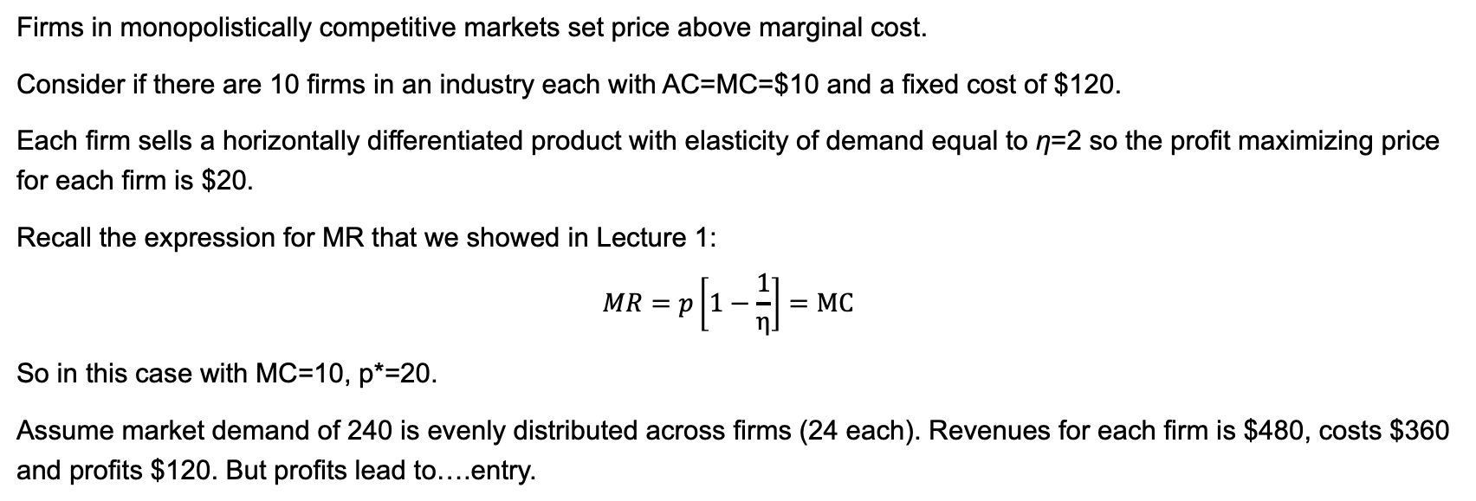
the entry decision
Firms in monopolistically competitive markets set price above marginal cost.
Consider if there are 10 firms in an industry each with AC=MC=$10 and a fixed cost of $120.
Each firm sells a horizontally differentiated product with elasticity of demand equal to η=2 so the profit maximizing price for each firm is $20.
Recall the expression for MR that we showed in Lecture 1:
$$MR=p\left[1−\frac{1}{η}\right]=MC$$
So in this case with MC=10, p*=20.
Assume market demand of 240 is evenly distributed across firms (24 each). Revenues for each firm is $480, costs $360 and profits $120. But profits lead to….entry.

Slide 12
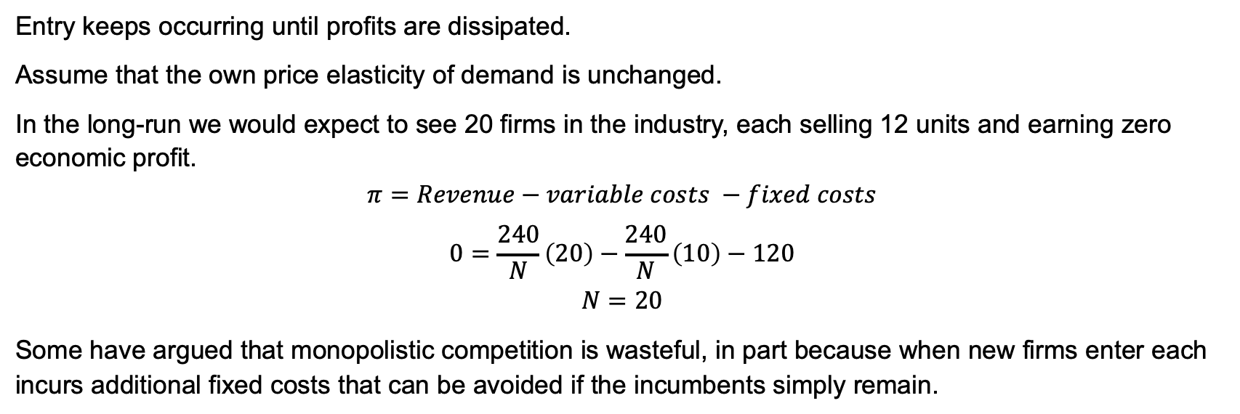
the entry decision
Entry keeps occurring until profits are dissipated.
Assume that the own price elasticity of demand is unchanged.
In the long-run we would expect to see 20 firms in the industry, each selling 12 units and earning zero economic profit.
$$π=Revenue−variable costs −fixed costs$$
$$0=\frac{240}{N}\left(20\right)−\frac{240}{N}\left(10\right)−120$$
$$N=20$$
Some have argued that monopolistic competition is wasteful, in part because when new firms enter each incurs additional fixed costs that can be avoided if the incumbents simply remain.

